Slide 1

Indian Institute of Technology , Patna
Topic : Deep Learning
Presented By :
Rutuj Waghare (2111MC10)
M.Tech – Mathematics and Computing
Guided By :
Dr. Prashant Srivastava
Associate Professor
Department of Mathematics
[1]

Slide 2
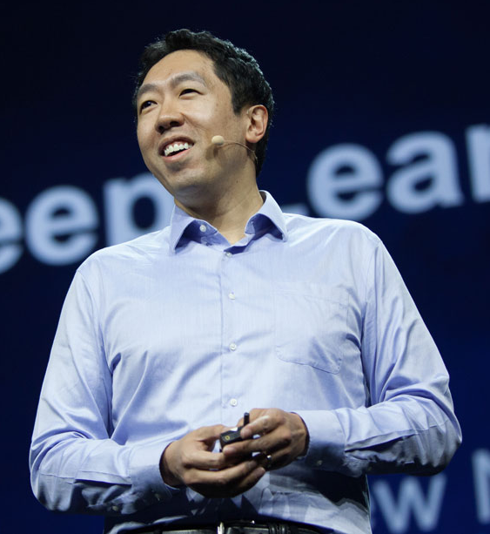
“
Ai is the new electricity.
- Andrew Ng
[2]
source : wipo.int

Slide 3
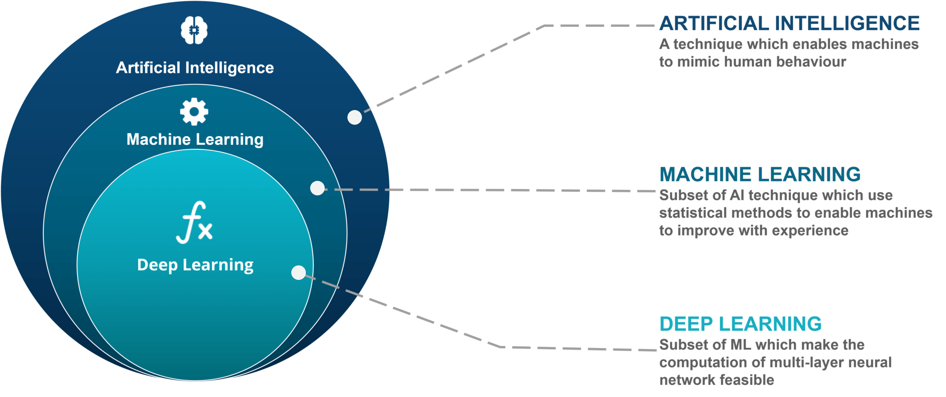
?
What exactly is Deep Learning
[3]
source : edureka.co

Slide 4
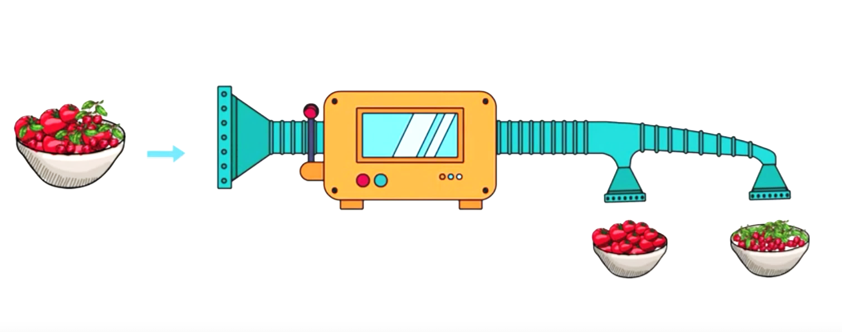
ML vs DL ?
[4]
source : simplilearn

Slide 5
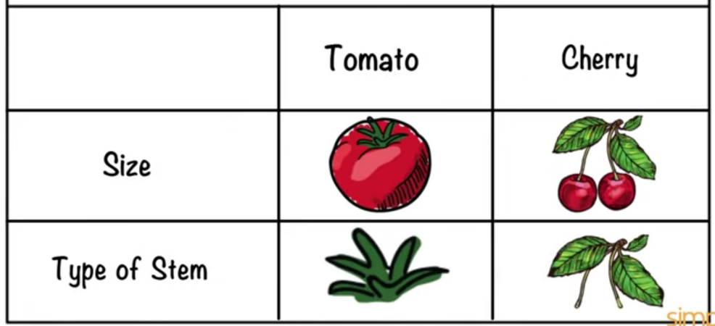
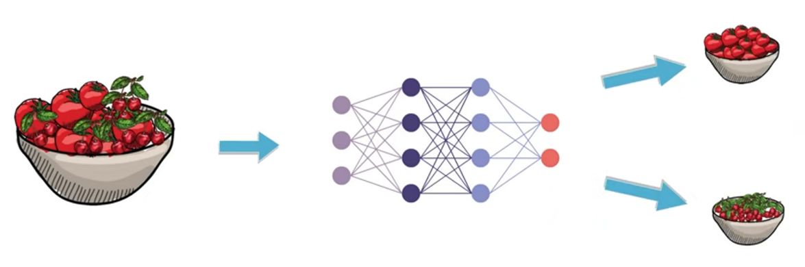
Machine Learning
Deep Learning
[5]
source : simplilearn

Slide 6
ML vs DL ?
Heavily depends on features
Requires good domain knowledge
Features extraction is not easy job
Can handle huge amount of data.
Allows system to rapidly adapt new task.
Can solve complex problems.
[6]

Slide 7
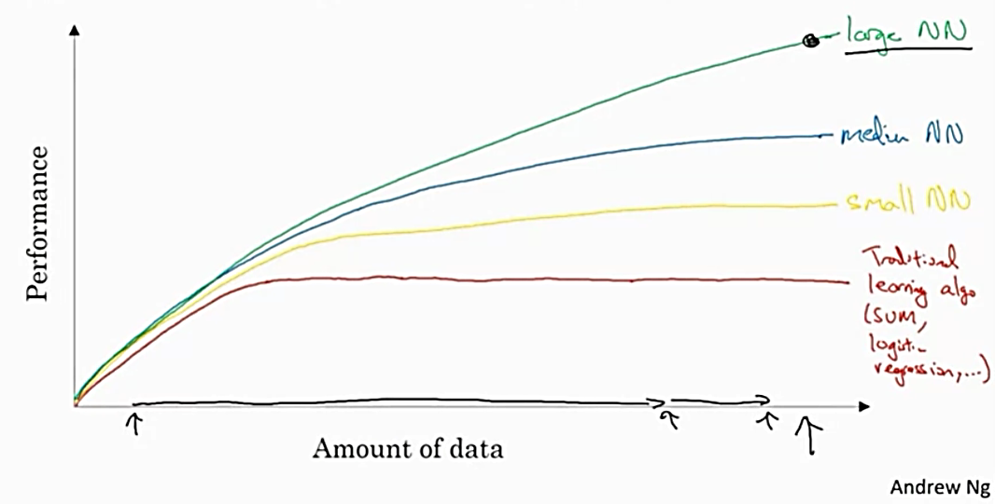
Why is Deep Learning taking off ?
[7]
source : Andrew NG

Slide 8
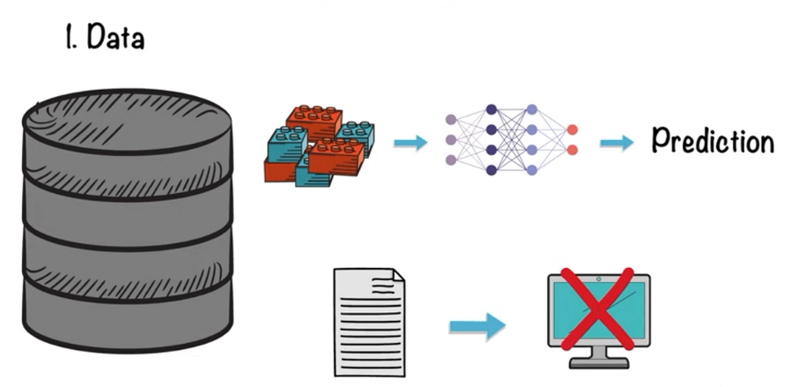
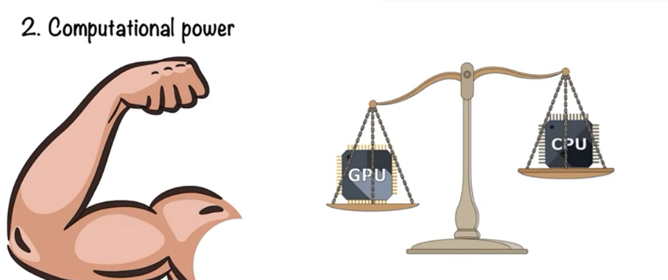
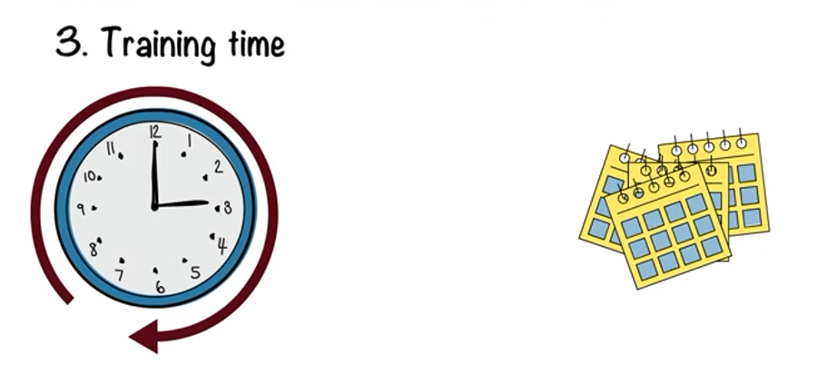
Limitations of Deep Learning
[8]
source : simplilearn

Slide 9
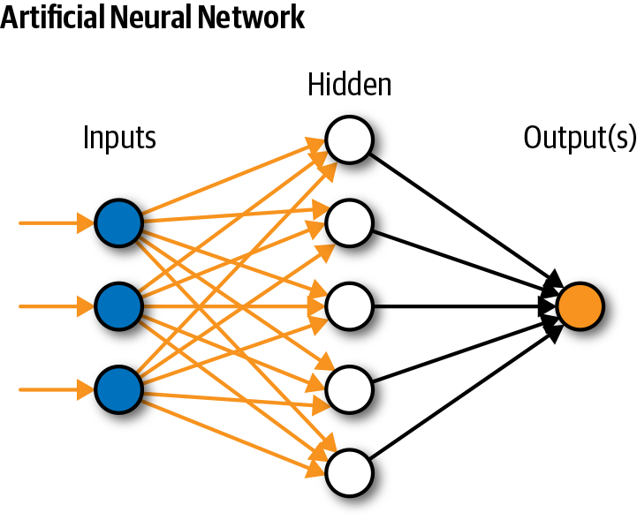
Neural Networks
The 30,000 feet view
Neural networks are multi-layer networks of neurons that we use to classify things, make predictions, etc.
[9]
source : stackoverflow

Slide 10
Terminologies ..
Perceptron : It is nothing but a simple layer neural network inspired by a biological neuron.
Input : Input is the data that we want to feed to the network. It is usually defined as x1,x2,…xn. Input can be of any form-text, images or video as a whole.
Output : The output is generated for the respective neuron that fires the activation.
[10]

Slide 11
Terminologies ..
Bias : It is used to adjust the output along with the weighted sum of the inputs which helps the model in a way that it can fit best for the given data.
Activation function : It is used to map the output as to between 0 to 1 or -1 to 1 depending on the type of activation function. There are various types of activation functions including sigmoidal, step, exponential functions etc.
[11]

Slide 12
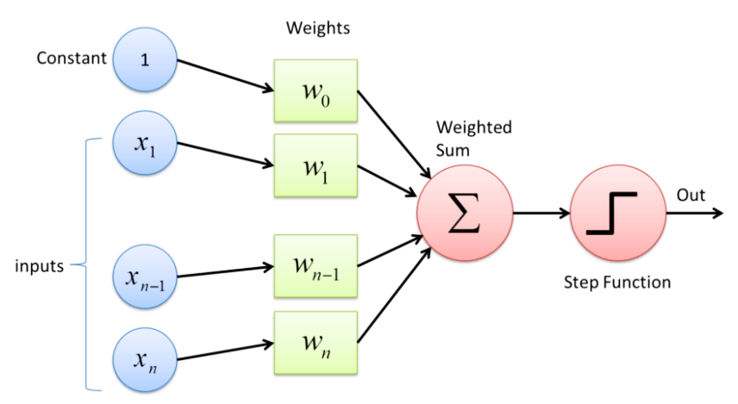
Perceptron
Perceptron is a single layer neural network and a multi-layer perceptron is called Neural Networks.
[12]

Slide 13
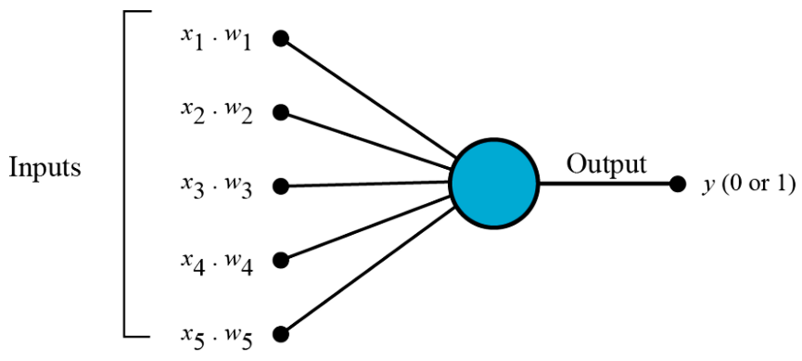
Perceptron - Working
All the inputs x are multiplied with their weights w. Let’s call it k.
[13]

Slide 14
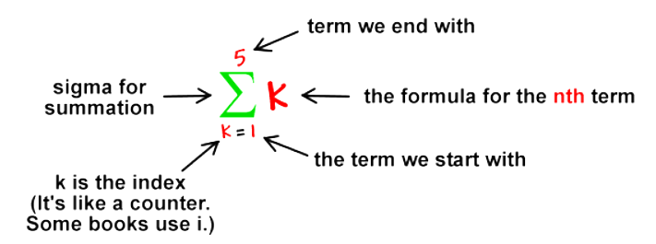
Perceptron - Working
Add all the multiplied values and call them Weighted Sum.
[14]

Slide 15
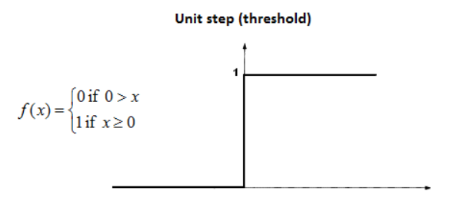
Perceptron - Working
Apply that weighted sum to the correct Activation Function.
[15]

Slide 16
References
[1] https://www.youtube.com/watch?v=6M5VXKLf4D4&t=4s&ab_channel=Simplilearn [Accessed on 9 Jan 2022 ]
[2] learning/lecture/praGm/why-is-deep-learning-taking-off [Accessed on 9 Jan 2022 ]
[3] https://towardsdatascience.com/neuralnetworks-implementation-d55cc6fc2f62
[Accessed on 10 Jan 2022 ]
[4] https://towardsdatascience.com/understanding-neural-networks-19020b758230
[Accessed on 10 Jan 2022 ]
[5] https://towardsdatascience.com/what-the-hell-is-perceptron-626217814f53
[Accessed on 10 Jan 2022 ]
[6] https://www.geeksforgeeks.org/effect-of-bias-in-neural-network/
[Accessed on 10 Jan 2022 ]
[16]

Slide 17
Thank You.
[17]

